Slide 1


Cyberbullying – what is it?

Slide 2
Cyberbullying – what is it?
Cyberbullying is bullying that takes place over digital devices like cell phones, computers and tablets. Cyberbullying can occur through SMS, Text, and apps, or online in social media, forums, or gaming where people can view, participate in, or share content.
Cyberbullying includes sending, posting, or sharing negative, harmful, false and/or mean content about someone. It can include sharing personal or private information about someone else, causing embarrassment or humiliation.

Slide 3






What’s Different About Cyberbullying?
Anonymity – the identity of the person who bullies can be kept secret. The target of the behavior experiences increased stress and anxiety due to the “unknown” factor.
Accessibility – the technology used to cyber bully can be accessed any time, day or night.
Number of “bystanders” – can quickly reach into the thousands depending on the online platform (eg. Youtube, Instagram, Snapchat)
Disinhibition – the secrecy of internet encourages those who might not otherwise bully to partake in the abusive behaviour.
No observable response – the person who bullies is not usually present to observe the impact of their words or actions have on others.
Notes:
RCMS Bullying Prevention Presentation 2012

Slide 4
Types of cyberbullying
Exclusion
Peer pressure
Stalking
Physical bullying
Blackmail
Digital character assassination

Slide 5

Exclusion
The cyberbully tries to alienate your friends or make your peer group mock or hate you, with the goal of leaving you alone and vulnerable.
Many cyberbullies will not stop at exclusion.
Once somebody has been excluded, the cyberbully often moves on to more serious attacks.

Slide 6
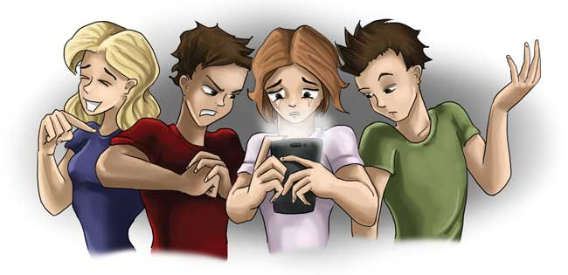
Peer pressure
The cyberbully tries to get you to do or say things that you don’t want to, by telling you that all the other kids do it or by saying that you won’t fit in.
Ironically, peer pressure is often used by cyberbullies to get people to help them bully other people.

Slide 7

Stalking
The cyberbully follows you on all your social media and gives you unwanted attention.
It can be rather creepy, actually.
This form of cyberbullying is quite common among adults as well.

Slide 8
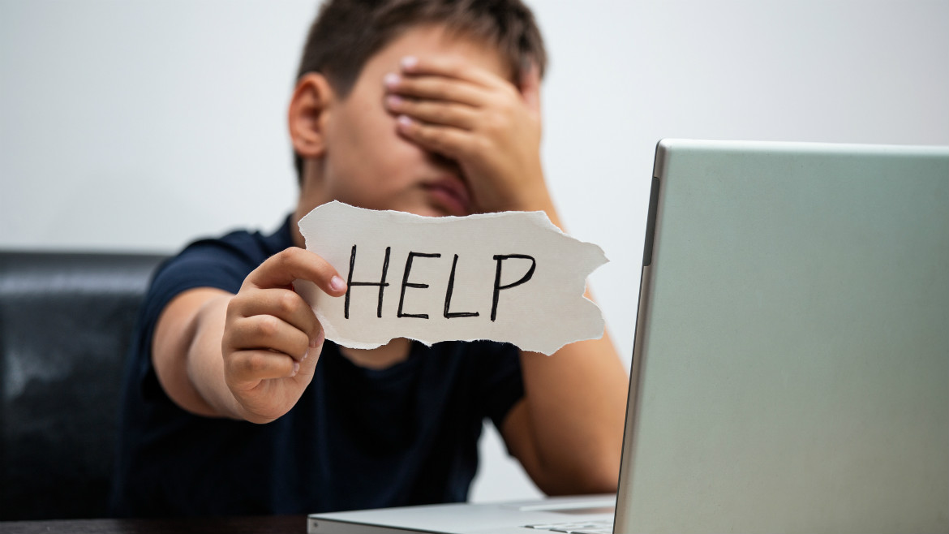
Physical bullying
If the cyberbully knows you in real life, he (or she) can combine cyberbullying with physical and/or social bullying.
“I know where you live and when you least expect it, I can be there. So you’d better not annoy me.”

Slide 9
Blackmail
The cyberbully threatens to reveal confidential information about you that would be embarrassing or even harmful to you.
Although, in some cases the information is obtained through hacking, usually it is obtained directly from the victim.
This can be an escalation of some of the previous types of cyberbullying.

Slide 10
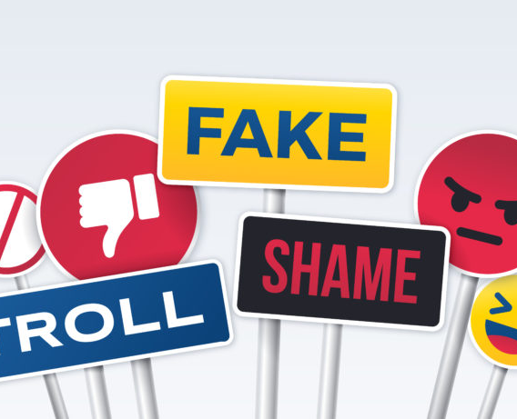
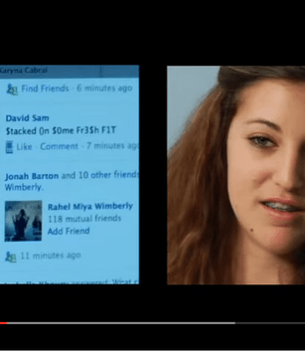
Digital Character Assassination
The cyberbully will stop at nothing to destroy as much of your virtual identity as possible, and usually hopes to destroy your real life as well.
This type of cyberbullying is also common among adults—in many cases the goal is to get you fired from your job.
Această fotografie de Autor necunoscut este licențiată în condițiile CC BY-NC
Această fotografie de Autor necunoscut este licențiată în condițiile CC BY-SA-NC

Slide 11
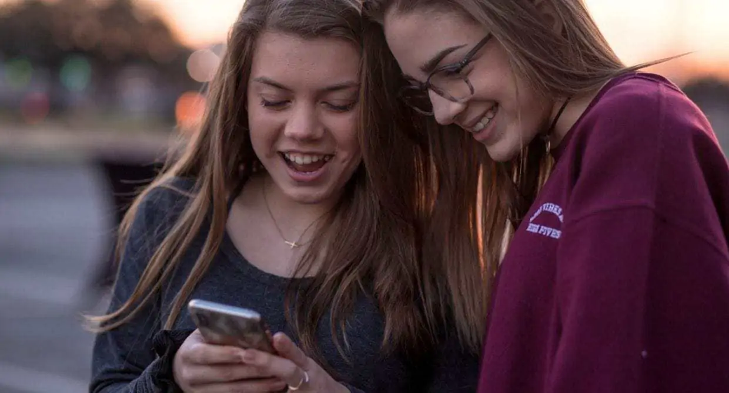
Why do kids Cyberbully one another?
It’s entertaining.
They want to get a laugh or reaction from the victim or bystanders.
Enjoy trolling (tormenting, teasing) others.
To help bolster likes, followers or social standing.
Some think they are standing up for others.
Notes:
RCMS Student Bullying Presentation 2012
Bullies have chosen hurtful ways to achieve emotional goals…or to take their anger out on someone else. Unfortunately, most of bullies lack insight to recognize their motivations.

Slide 12
How can cyberbullying affect you?
Feelings of guilt
You may feel trapped in a hopeless situation
You can feel alone, like no one is supporting you
You may feel excluded
Feelings of depression, distress and rejection by each group
Feelings of fear and insecurity
Anxiety and stress

Slide 13
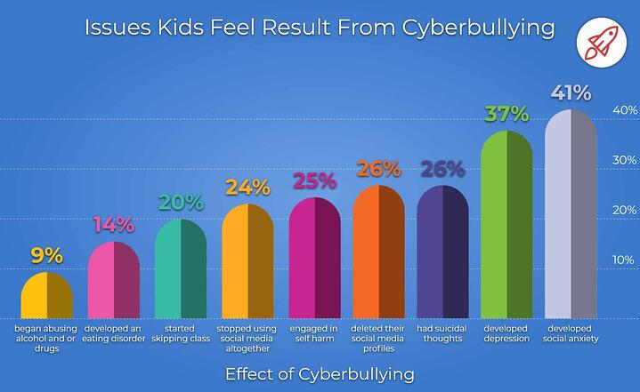
Source: www.broadbandsearch.net/

Slide 14
Some things you can do if you feel you’re cyberbullied
Tell someone you trust about what's going on so that you can get help.
Save emails, texts, comments, etc., that could serve as evidence of the cyberbullying.
Don't strike back. Two wrongs don't make a right.
Report the issue to the website. For example, Facebook and YouTube both have places where you can report cyberbullying in a safe environment.
Never bully back because it will only continue the cycle of bullying behavior.
Don’t respond to or forward cyberbullying messages.

Slide 15
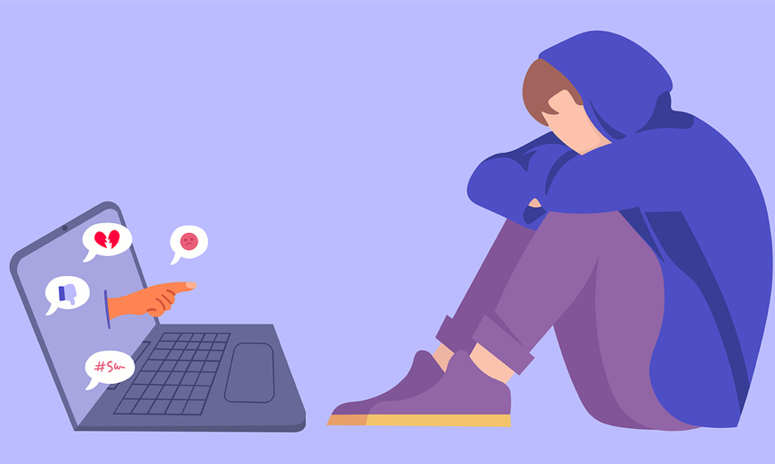
How to Respond to Cyberbullying?
Block cyberbullies!
It will be harder for someone to bully you if they can’t reached you.
Report cyberbullying!
Report the incidents to your online service providers. Harassment is a violation of the “terms of service” for most providers.
Report inappropriate behavior!
Report the bullying to social media platforms.
Notify police!
If someone threatens you or if someone you know is in danger, contact the police.

Slide 16
How is Cyberbullying Prevented?
Change your online and social media settings to “private” to help prevent your information from getting into the wrong hands.
Communicate only with people you personally know .
You shouldn’t follow strangers or allow strangers to follow you.
Think before posting.
Posts are permanently online, so don’t post something you’ll regret.
Never share your personal information online, including passwords.
Never meet face to face with someone you’ve met online.

Slide 17
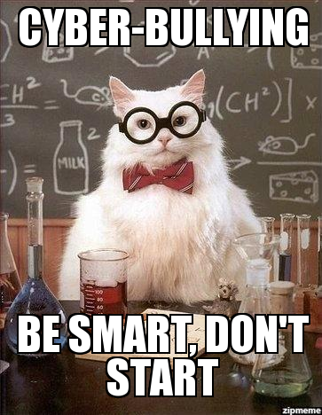
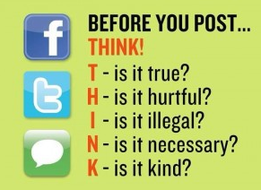

Slide 18

"I Like It" is an anti-cyber bullying rap performed by the GMCBeats Youth Crew to celebrate Safer Internet Day 2015. Music & lyrics written, produced & recorded at GMCBeats Rap Workshops (run by Garry McCarthy.

