Slide 1
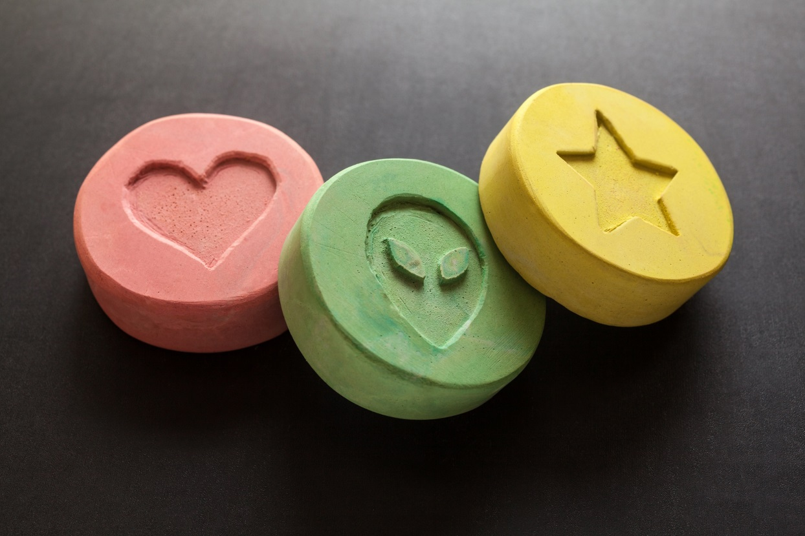
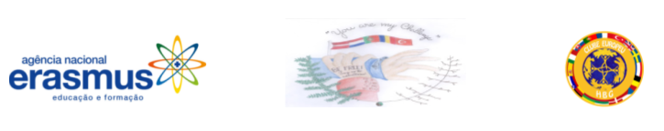
Drugs

Slide 2
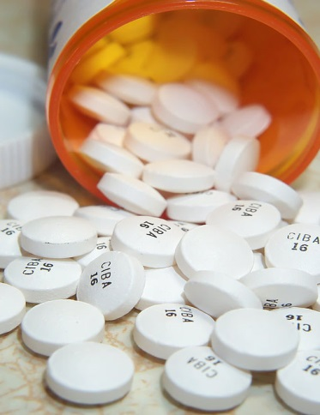
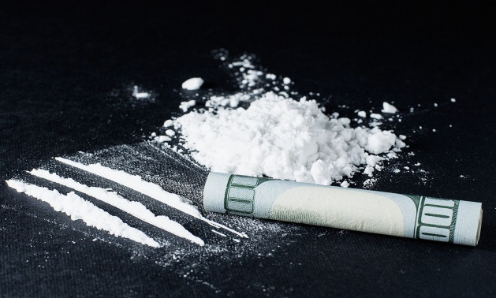
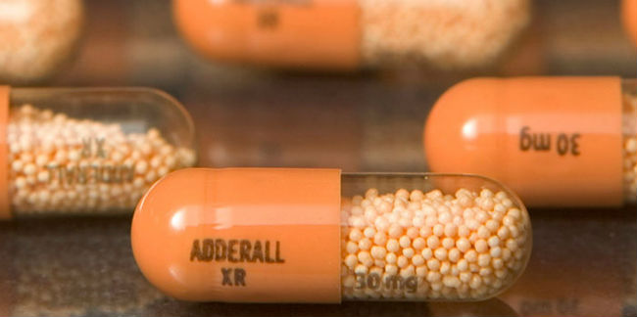
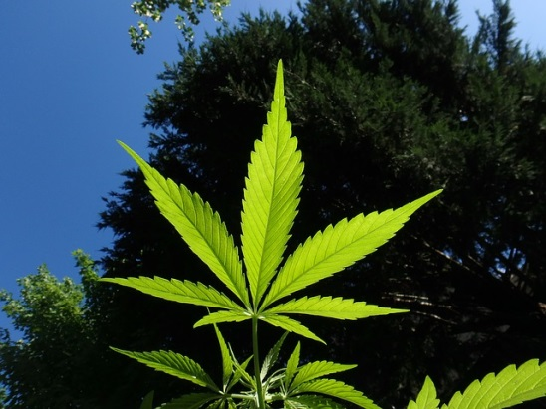
Today drugs are something widely used. A lot of people try, but our question is:
☞ What are drugs and are they good for us?
Well, drugs are substances which have a psychological effect when ingested or introduced in our body. And no, they aren´t good. They can be really dangerous for you.
That´s why we´re going to present you some types of drugs, their consequences and other facts that you might know.
There ´re various types of drugs like cocaine, adderall, ritalin, marijuana…
These are classic ones, but there´s one special that I´m going to focus on
and its name is ECSTASY.
Ecstasy is one of the most dangerous. So dangerous that could be deadly.

Slide 3
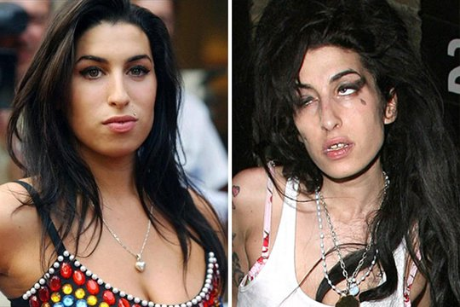
Characteristics and effects of Ecstasy:
Ecstasy is one of the most used today, mainly, by teenagers;
It causes thirst;
It has no flavor, color or smell;
It is not easly detected by blood tests, what is really bad;
Victims need to undress, because they feel extreme heat;
It causes sexual needs;
(Amy Winehouse)

Slide 4
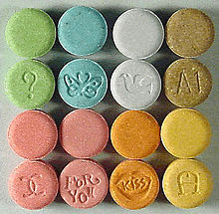
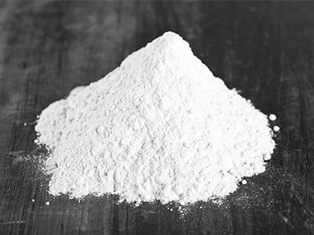
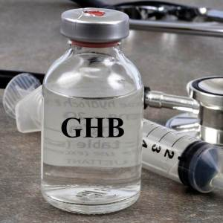
Ways in which ecstasy can be presented:

Slide 5
1- In tablet form ;NEVER, BUT NEVER ACCEPT IT! IT´S A DRUG! Drugs cause addiction.
2- In powder form
3- In liquid form: Be careful, in our opinion this is the most dangerous way, because just a little distraction and we become victims of this drug. For example, in public places, like clubs, always hold your glass over the top it. Sometimes people put some drops into your drink.
1
2
3

Slide 6
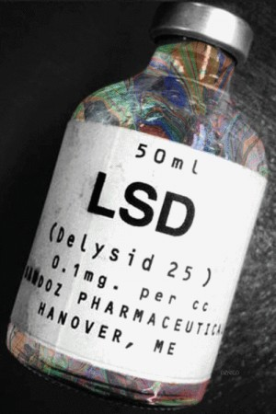
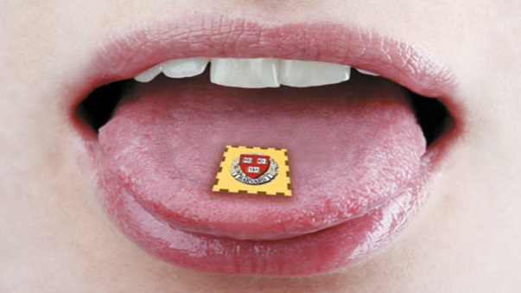
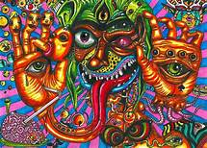
LSD
It´s an extremely potent hallucinogen that became popular in 1938.
It´s extremely powerful and hard to predict it´s effect on people
It can affect the human brain in a large scale, turning people into “ vegetables” or in the medical term “ Brain death”, caused by seizures.
Also, studies confirm a variety of symptoms : anxiety ,depression and paranoia.
The main cause of death from LSD in the past years has been suicide. By overusing this product, people tend to suicide themselves due to the lack of consciousness.
It´s mostly described by users as a colorful drug that can present you your dream world, your fantasies.

Slide 7
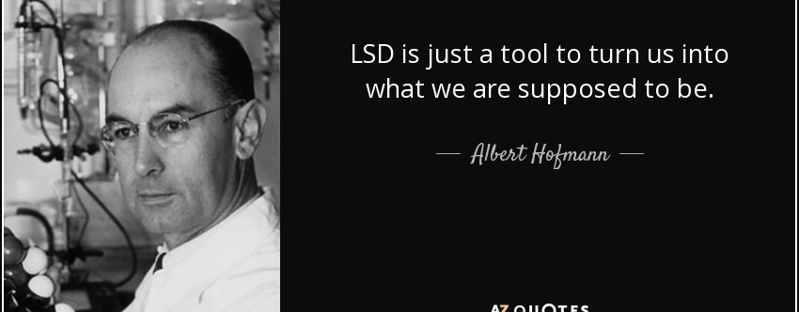
the CREATIVE PROCESS BEHIND HOLLYWOOD
Through out the years many artists have described LSD as a powerful tool to interact with their creativity.
Musicians like Miley Cyrus, Axel Rose, Janis Joplin,Jimi Hendrix ,Freddy Mercury and even Steve jobs, one of the great minds in the 20th century, Apple´s creator, have admitted the use of this drug.

Slide 8
LAW
It is extremely important for young children to understand the consequences of using drugs in Portugal.
USA: SOME STATES, consider drugs as Marijuana and some hallucinogenics legal, for medicinal causes or even recreational causes. That´s the main reason television series and American movies describe drugs as being legal. You are only aloud to consume them when you´re over 21 and with the state´s approval.
Portugal: Here in the European Community our drug policy is stricter.
We do not allow any citizen to consume hard drugs, such as Cocain, LSD, Heroin.
We are also strict with the use of lighter drugs such as Hax and Marijuana.
Portuguese law does not allow Portuguese citizens to consume any type of drugs. The medicinal use of marijuana is strictly provided by the government to cancer of extreme diseases patients who want to relieve their pain.
Punishment: Jail time up to 10 years.

Slide 9
Be free!
Take care of you!
School: Dr. Horácio Bento de Gouveia
MADEIRA PORTUGAL

