Slide 1
Healthy Food
Made by Mo, Esmee and Zoë

Slide 2
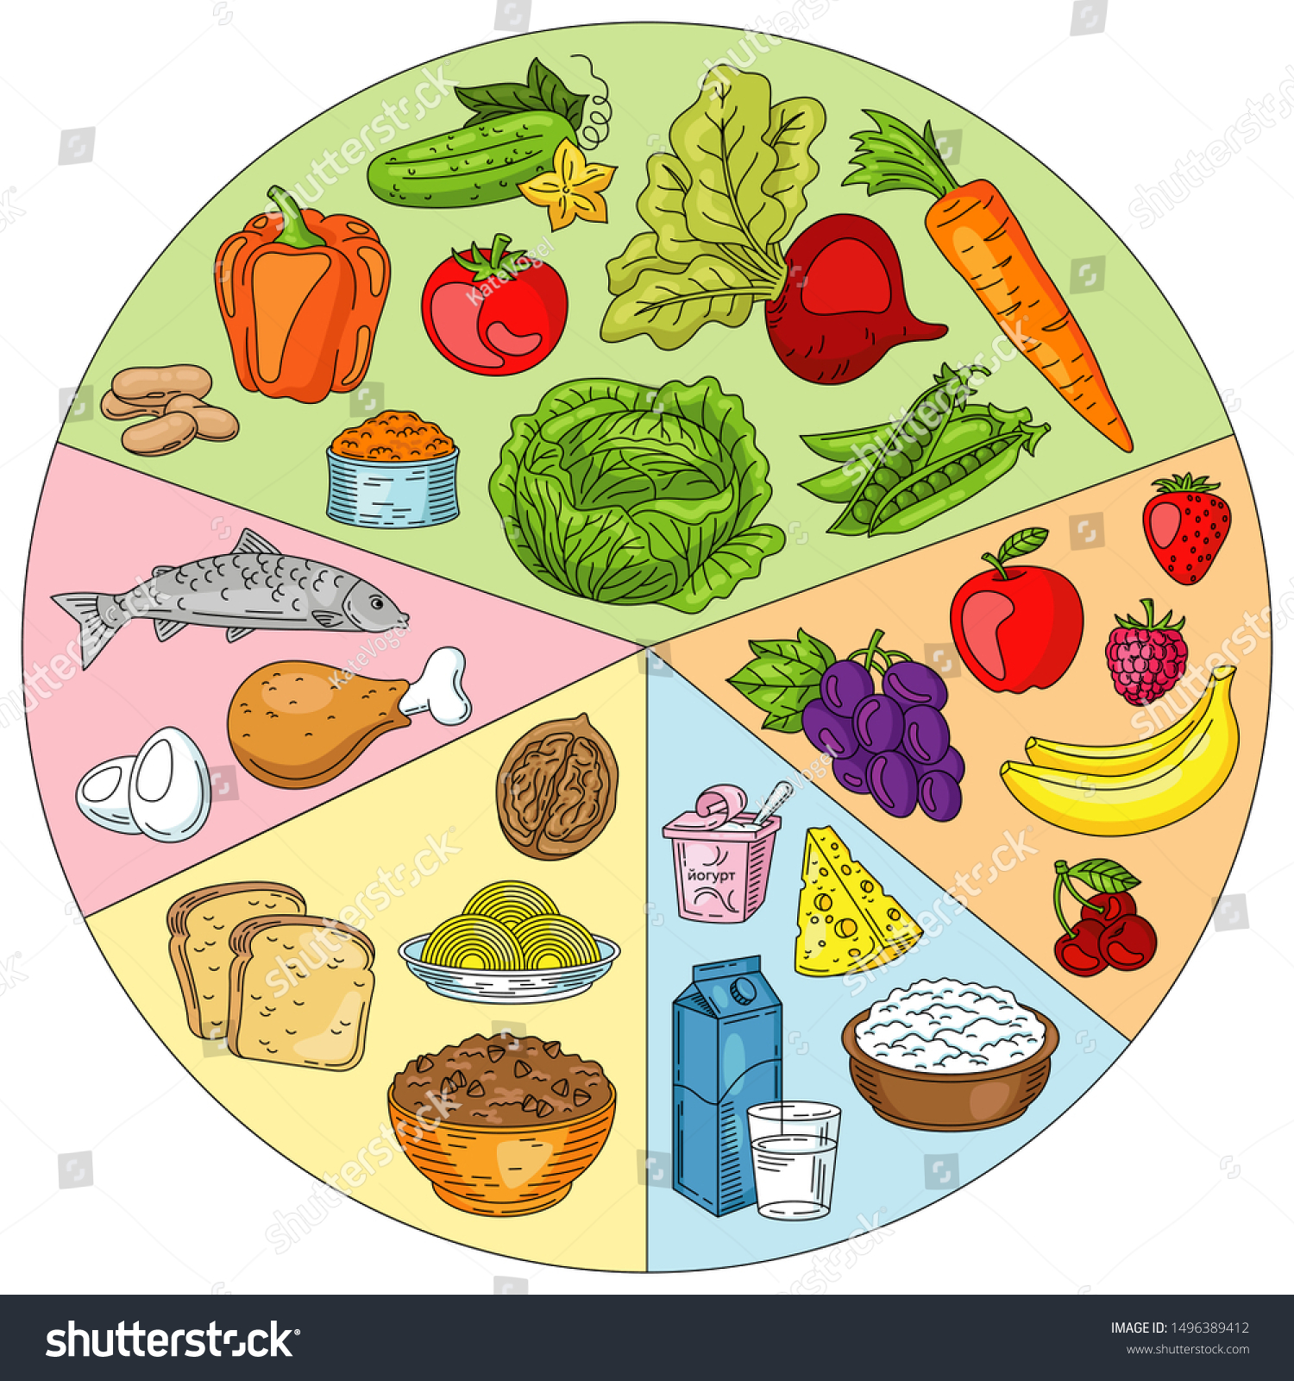
Introduction
1.What is healthy food.
2. Wheel of 5 / variation of foods.
3. Why 3 meals on a day.
4. Vitamins.
5. The end.

Slide 3
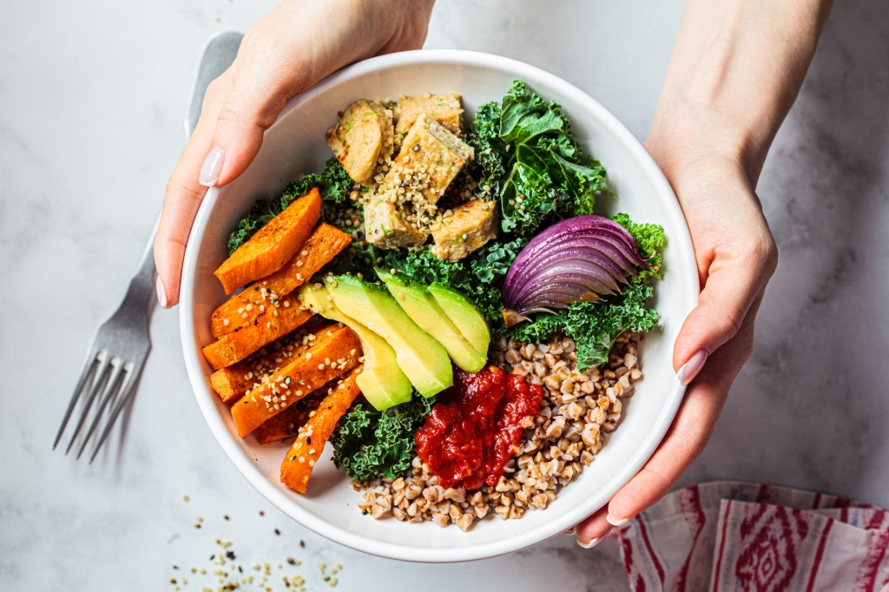
What is healthy food.
Healthy eating means, among other things, a lot of variety in food, offering regularity and serving dishes with the right nutritional values. It is important to get good and healthy food that makes you feel vital so that you can eventually participate in all activities when you want to.

Slide 4

Wheel of 5
These are the boxes from the Wheel of Five:
Vegetables and fruit.
Lubricating and cooking fats.
Fish, vegetables, meat, egg, nuts and dairy.
Bread, cereals and potatoes.
Drinks.

Slide 5
Why three meals on a day
By limiting the number of eating moments per day to 3 balanced and protein-rich meals, you will consume fewer calories and thus prevent fatty liver and the development of belly fat. At the same time, with 3 meals a day, the muscle mass and the hormone balance will be maintained or brought up.

Slide 6
Vitamins
Fruit and vegetables | Vitamins A and C
Bread, grain products & potatoes | Vitamins C and B11 (folic acid)
Meat (substitutes), fish, legumes, dairy & nuts | Vitamins A,D and B
Spreading & cooking fats | Vitamins A, B11, D and E
Drinks | -1

Slide 7
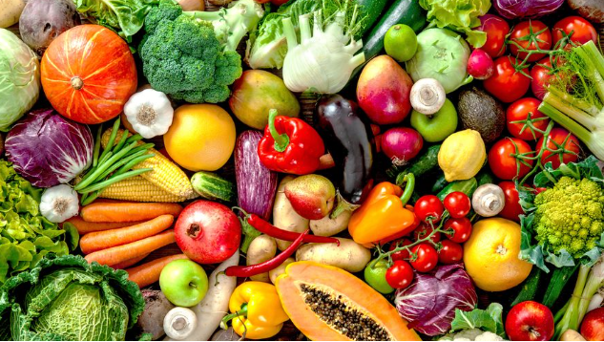
This was our presentation about Healthy food
We hope you learned something about healthy food
Made by
Zoë
Esmee
Mo

