Slide 1
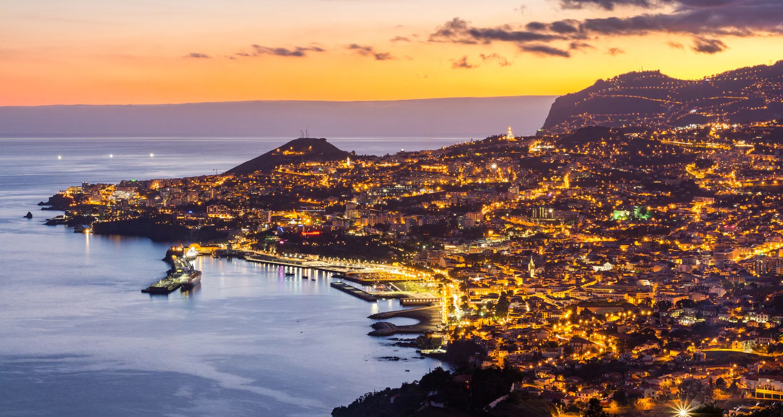
Photos Madeira Island
Visit us
Funchal
Bay!

Slide 2
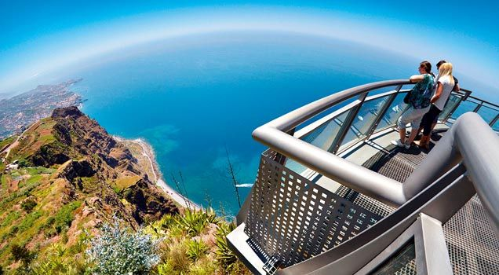
Explore our Island
580 metres high!
In first hand!
View of
Cabo Girão!

Slide 3
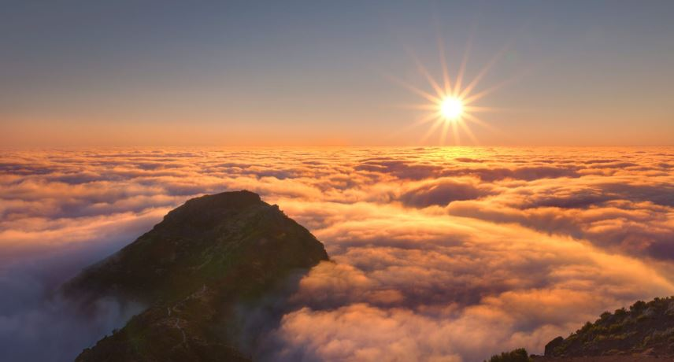
Pico do Areeiro
1 818 meters!!

Slide 4

The Madeira Island
Madeira Island, also known as The Pearl of the Atlantic, is the main island of the Madeira archipelago.
On the south-west of the Portuguese coast, it is made up of the islands: Porto Santo, Desertas Islands and Selvagens Islands, with its capital being the city of Funchal.
Madeira Island is of volcanic origin. It has an area of ​​approximately 742.4 km² and is highly praised for its extensive endemic, native and exotic flora. Its climate is typically Mediterranean in the south, on the other hand, the temperate climate prevails in the north.
The main activity of the Madeiran economy is tourism.

Slide 5

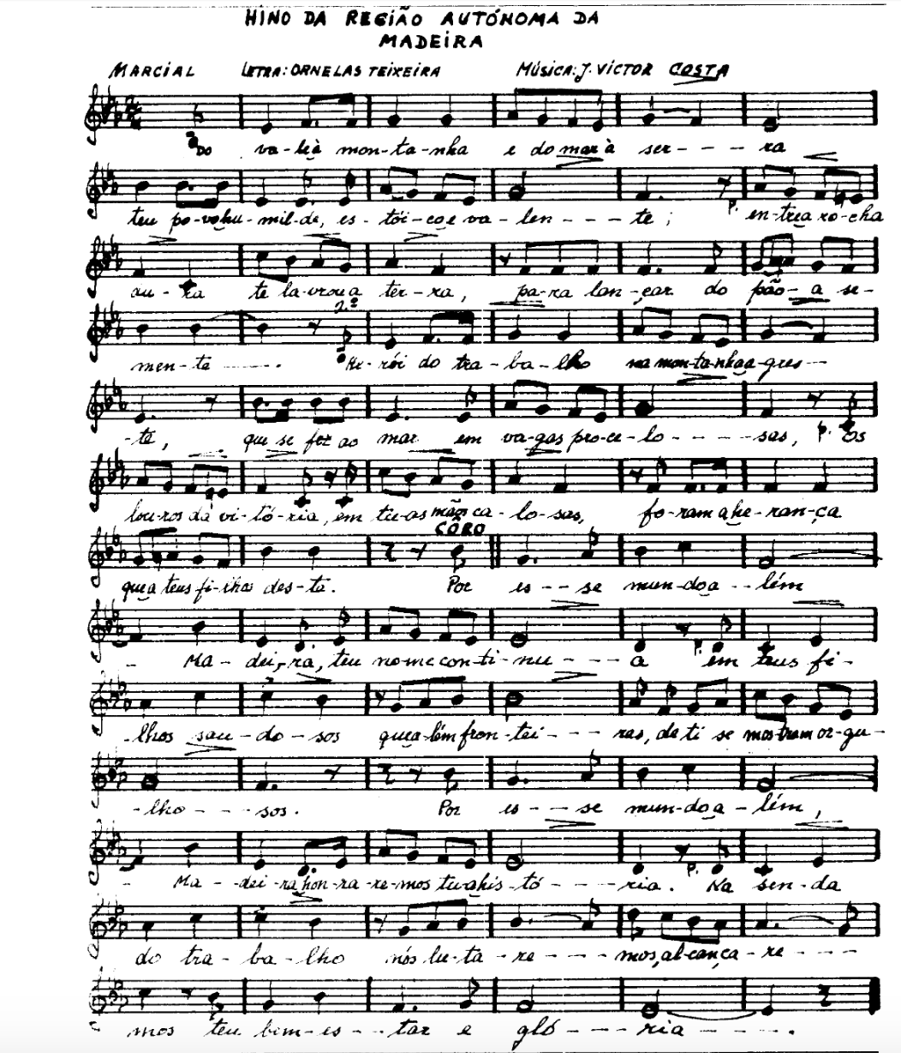
Anthem of Madeira
The Anthem of the Autonomous Region of Madeira is one of the official symbols of the region, together with the flag, coat of arms and seal. The anthem, created in 1980. It has lyrics by Ornelas Teixeira and music by João Victor Costa

Slide 6
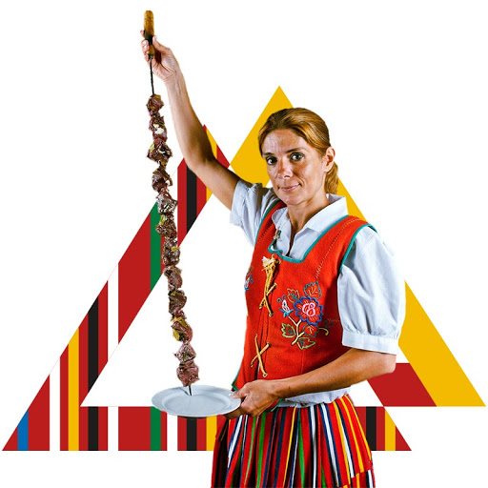
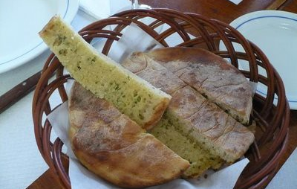
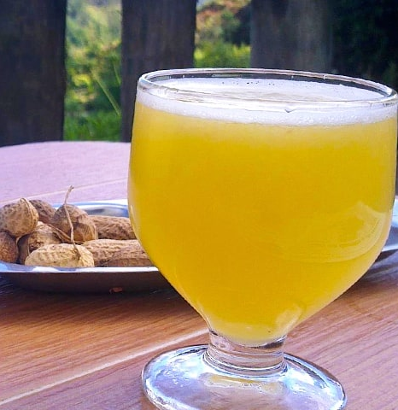
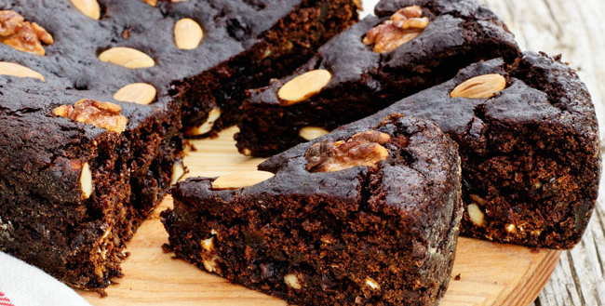
Gastronomy
Humm!

Slide 7
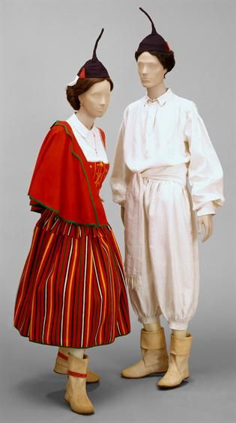
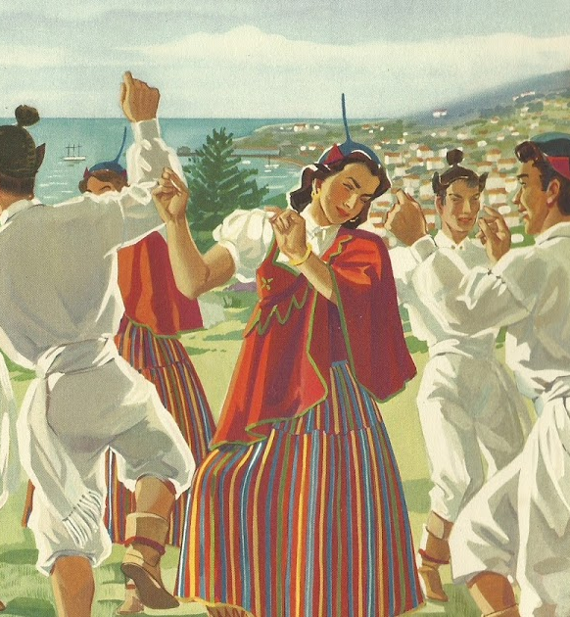
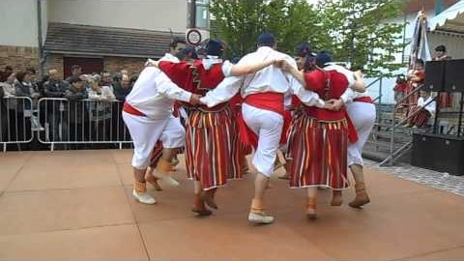
Bailinho of Madeira

Slide 8
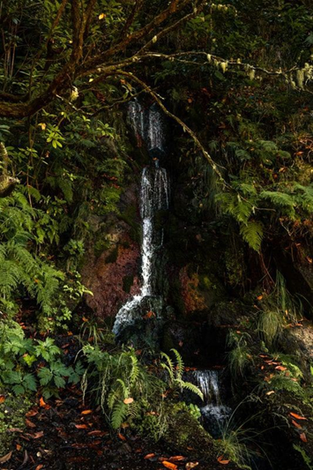
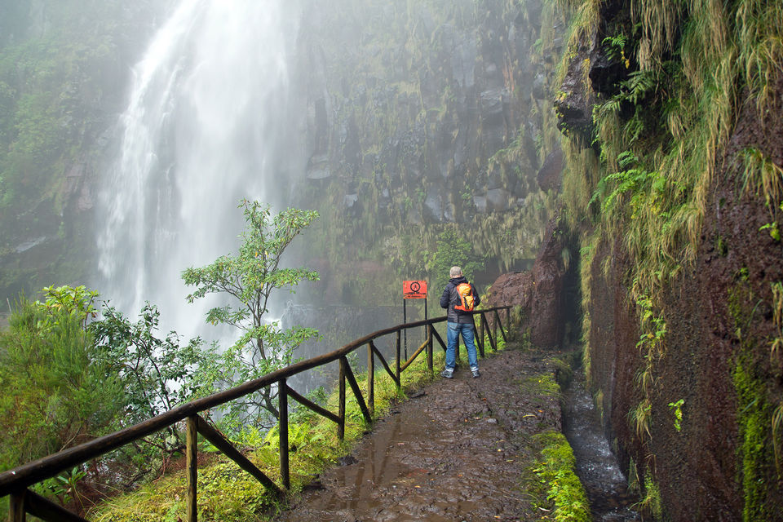
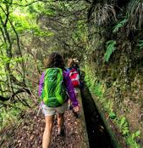
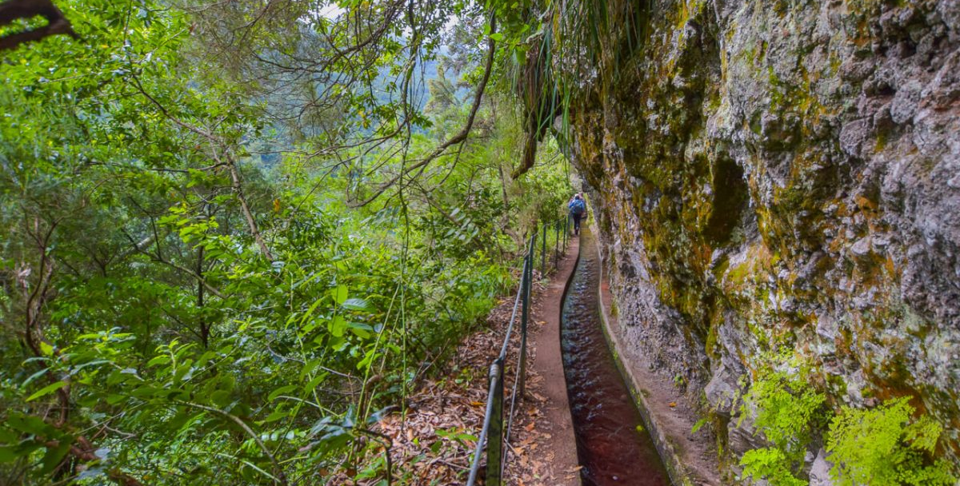
Walk in the Nature
Adventure!!

Slide 9
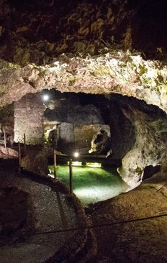
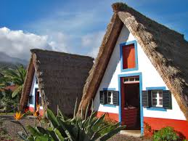
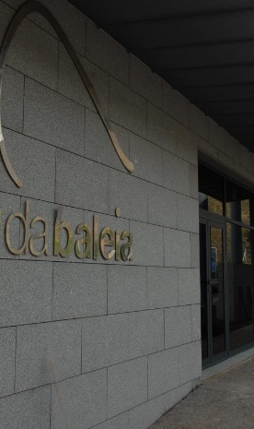
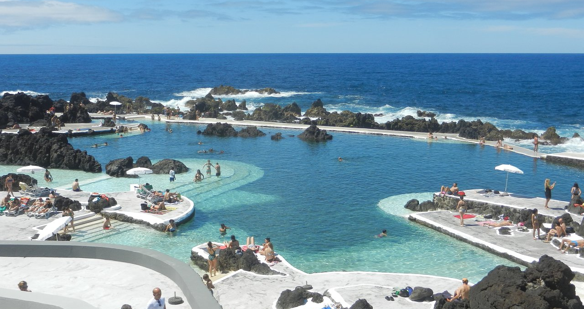
Places to visit
São Vicente, Santana, Porto Moniz, Caniçal
To have a great day!

Slide 10
Saint Vicente Caves
One of the best-known tourist attractions on our island are the St. Vicente caves, which are in the council of St. Vicente. These caves were formed 890 thousand years ago from a volcanic eruption that occurred in Paul da Serra, which went down to the sea, which caused the outer part, exposed to lower temperatures, to rapidly solidify, while the interior continued running with lots of gases, forming a series of lava tubes, which today make up the St. Vicente caves.

Slide 11
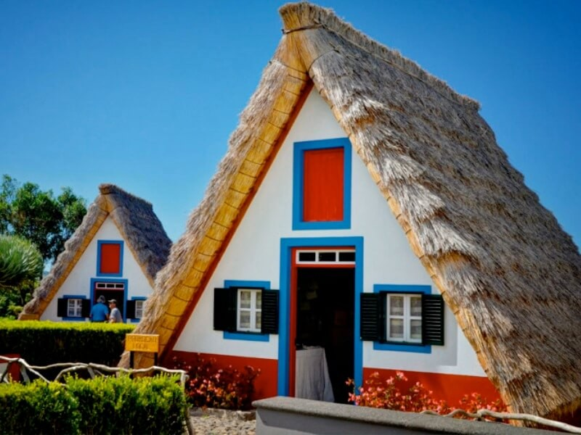
Santana's house
It’s believed that these houses are vestiges of primitive constructions, made of wood and thatch, a type of stem, which were found all over the island. As there is little hard stone in the region and the climate is cold in winter, this raw material was adopted, also enabling an adaptation to the seasons of the year, which are cool in summer and warm in winter.

Slide 12
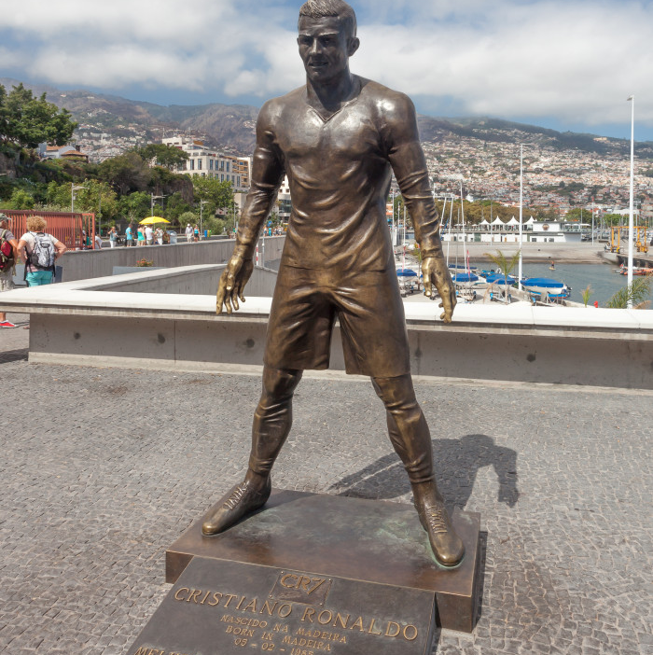
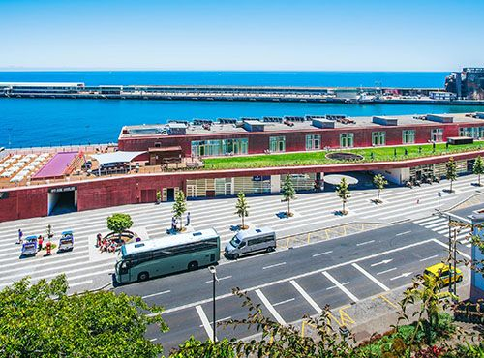
CR7 square

Slide 13
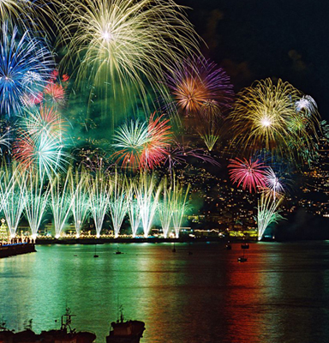
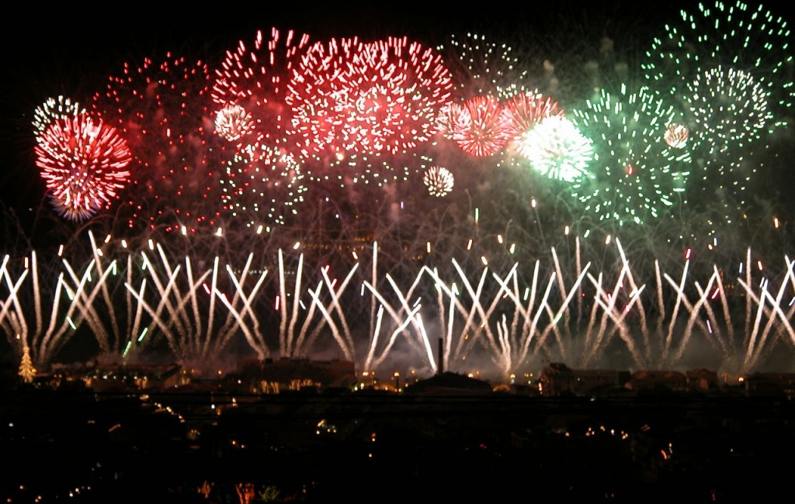
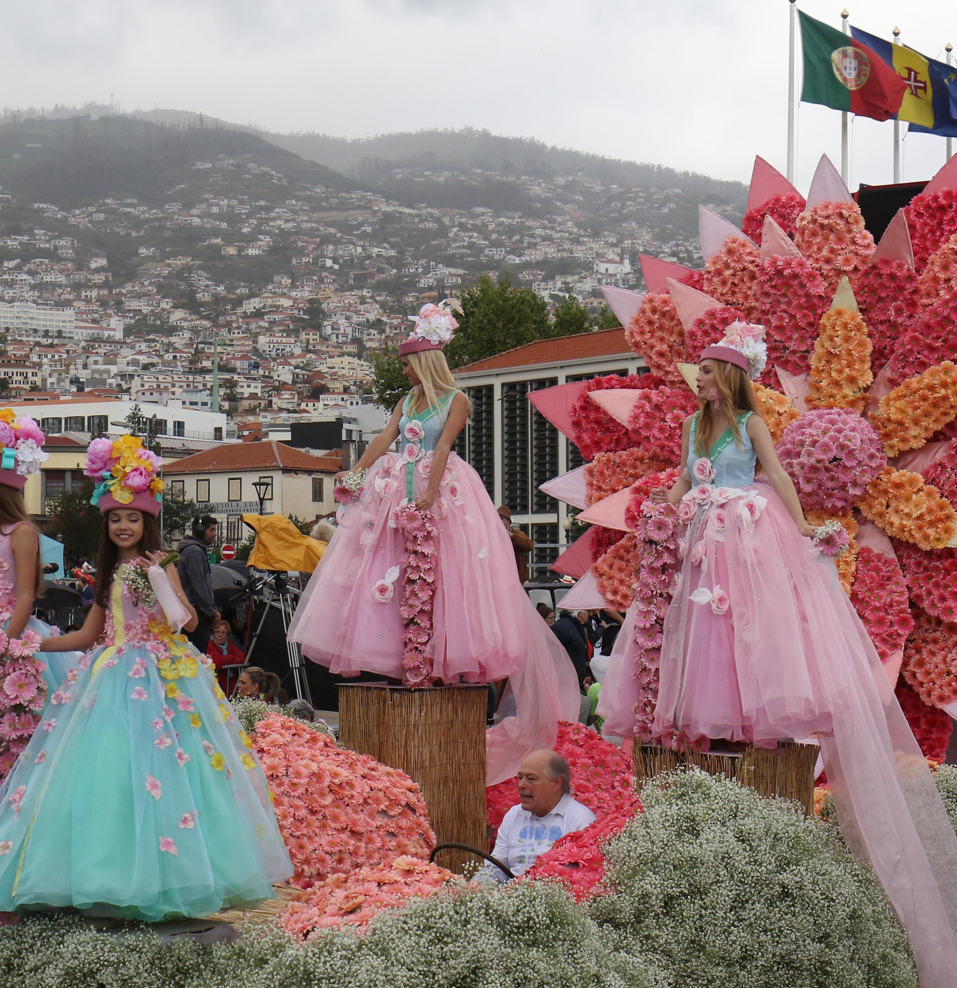
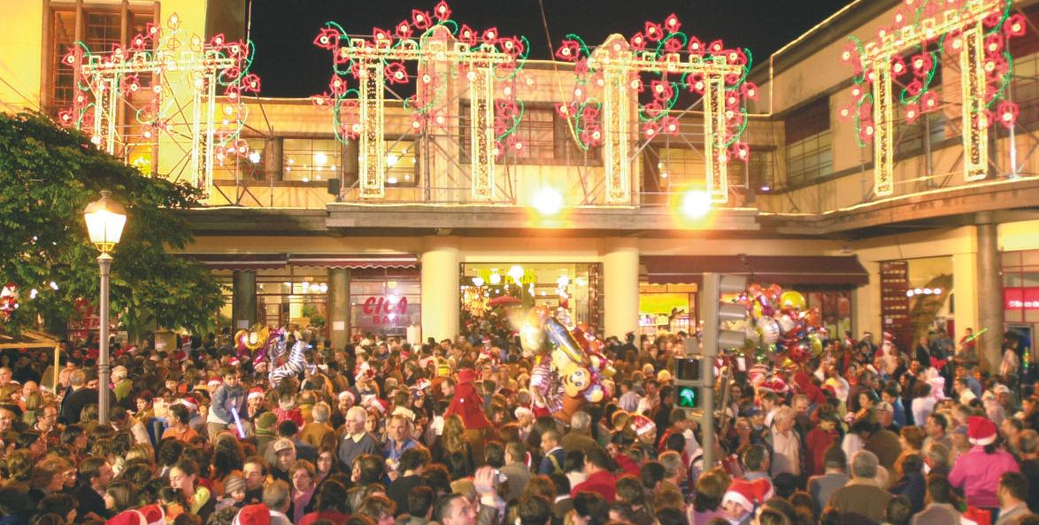
Some of our festivities
Most wanted!!

Slide 14
Come and visit us!

