Slide 1
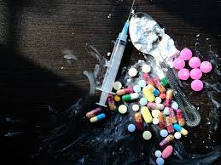
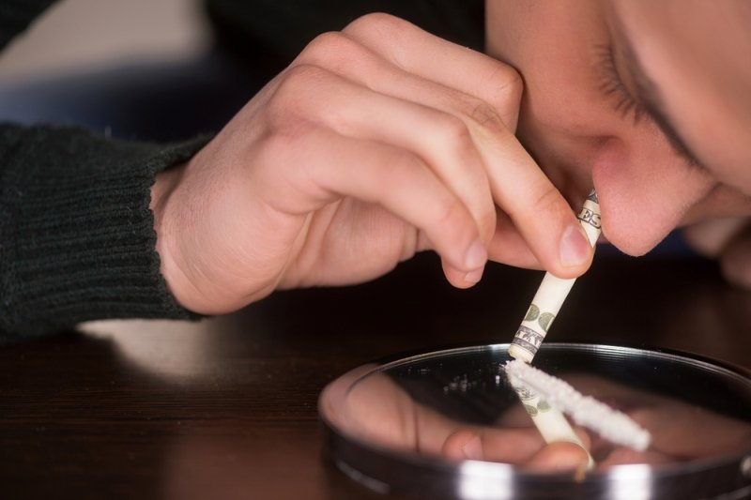
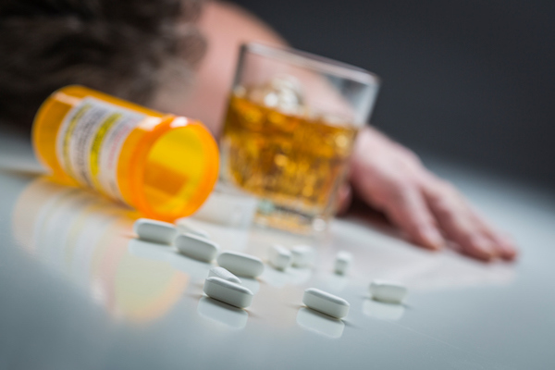

SUBSTANCE DEPENDENCE
By: Tiago Baptista and Tomás Abreu

Slide 2
TYPES OF ADDICTIVE SUBSTANCES
Nicotine
Alcohool
Drugs
Others…

Slide 3
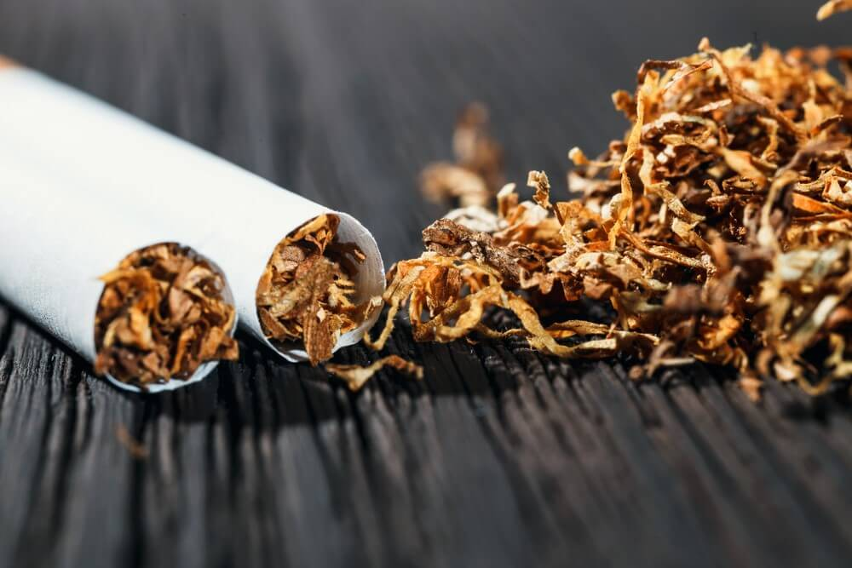
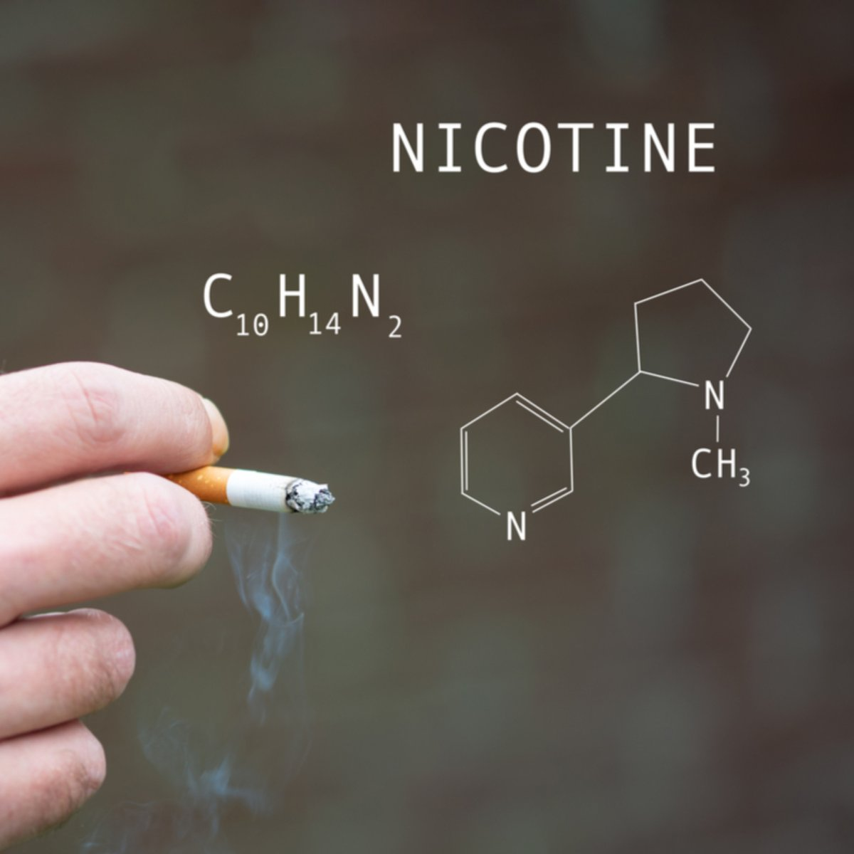
NICOTINE
Nicotine is a naturally created alkaloid in the nightshade group of plants and is broadly utilized casually as an energizer and anxiolytic. As a drug, it is utilized for smoking end to assuage withdrawal symptoms.
Nicotine comprises around 0.6-3.0% of the dry load of tobacco.
Nicotine is profoundly addictive.
Nicotine use as an apparatus for stopping smoking has a decent wellbeing history.
Animal examinations propose that nicotine may antagonistically influence mental advancement in puberty, however the importance of these discoveries to human mental health is disputed.

Slide 4

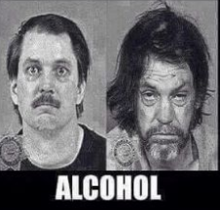

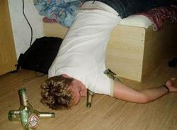
ALCOHOL
Alcohol is a psychoactive drug that has been consumed in drinks for most of history. In chemistry, the term alcohol refers to a whole class of organic compunds that include a hydroxyl group - consisting of an oxigen atom and hydrogen atom - bonded to a carbon atom.
In common parlance, howerver, the word alcohol usually refers to a specific chemical with the formula C2H5OH, which chemists call ethanol.

Slide 5
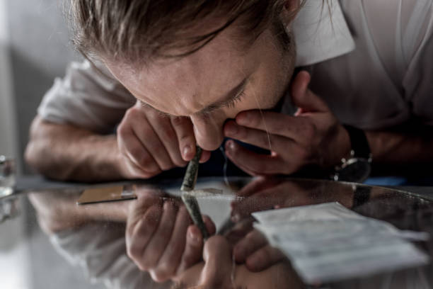
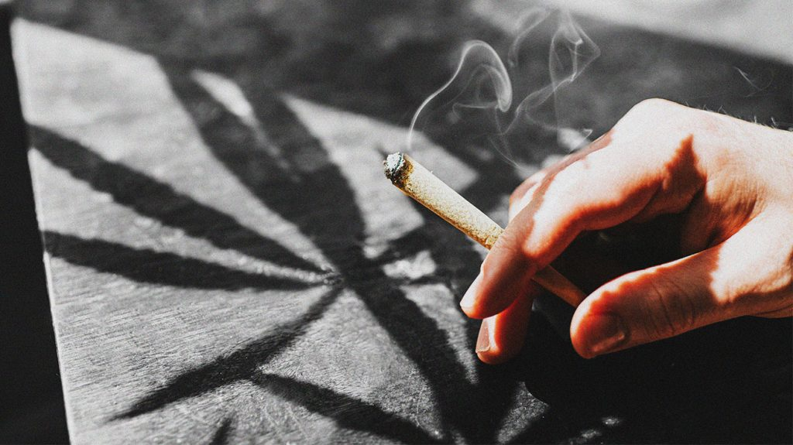
DRUGS
There are several types of drugs, but the most recognized are:
- Cocaine
- Heroin
- Opium
- Weed
- …
A drug is any synthetic substance that causes an adjustment of a living being's physiology or brain research when consumed. Drugs are regularly recognized from food and substances that offer nourishing help. Utilization of medications can be through inward breath, infusion, smoking, ingestion, retention by means of a fix on the skin, suppository, or disintegration under the tongue.
In pharmacology, a drug is a synthetic substance, commonly of known design, which, when regulated to a living creature, delivers a natural effect. A drug, likewise called a prescription or medication, is a compound substance used to treat, fix, forestall, or analyze a sickness or to advance well-being.

Slide 6

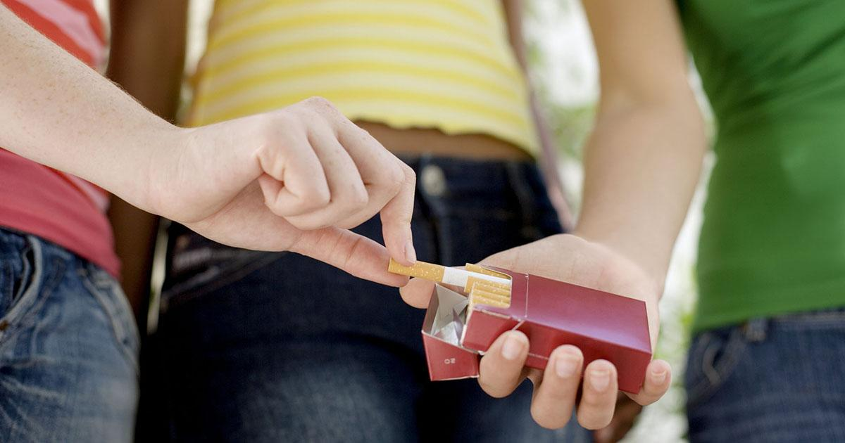
TEENAGERS AND RISK BEHAVIOURS
Teenagers usually think that things that happen to others won’t happen to them:
EXAMPLES:
- Children of smokers are more likely to smoke, even if their parents had traumatic experiences related to tobacco usage.
- Teenagers often ignore the fact that they might be targets to life-threatening diseases.

Slide 7
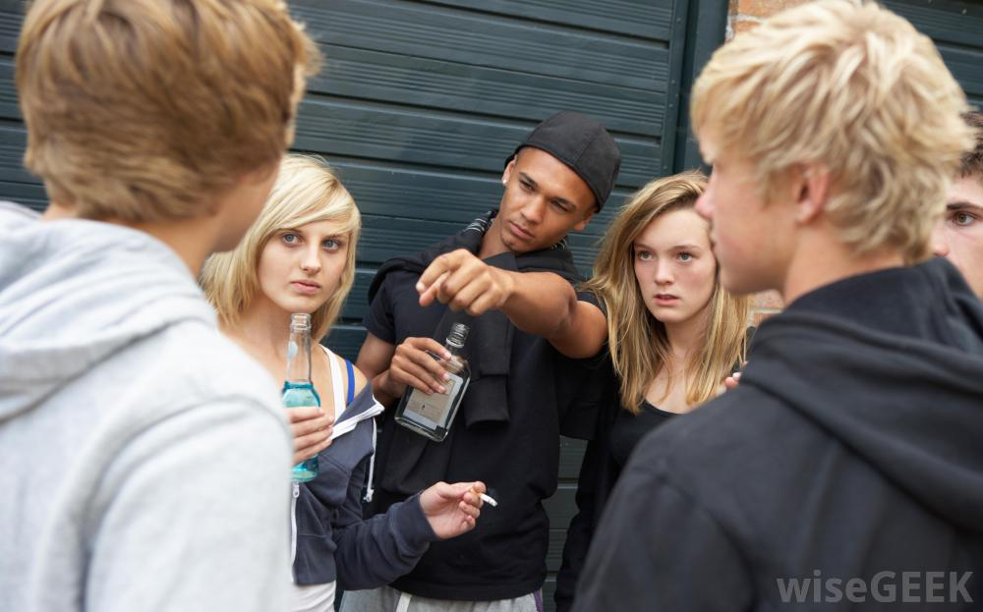
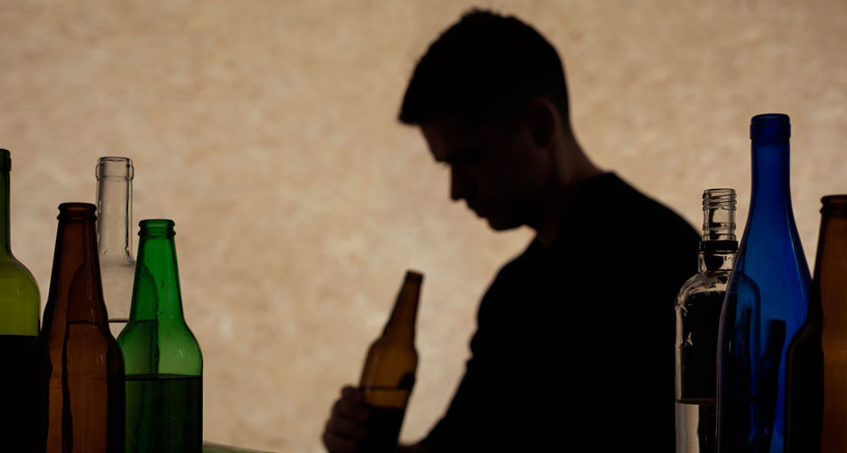
WHY DO THEY DO IT?
Several factors can lead teenagers to start behaving in a wrong way, such as:
- Friends’ pressure
- Curiosity
- Stress relief
- Invitations
- Feeling unloved by their parents
- Habing the sensation that they don’t fit in
- Many more…

Slide 8



HOW TO HANDLE IT?
It probably won’t be easy to take a teen out of the wrong path, but there are some techniques that might help:
-Talking about behaviour and consequences
-Working out agreed rules
-Talking about values
-Encouraging a wide social network
-Helping a teen handle peer influence

Slide 9


