Slide 1

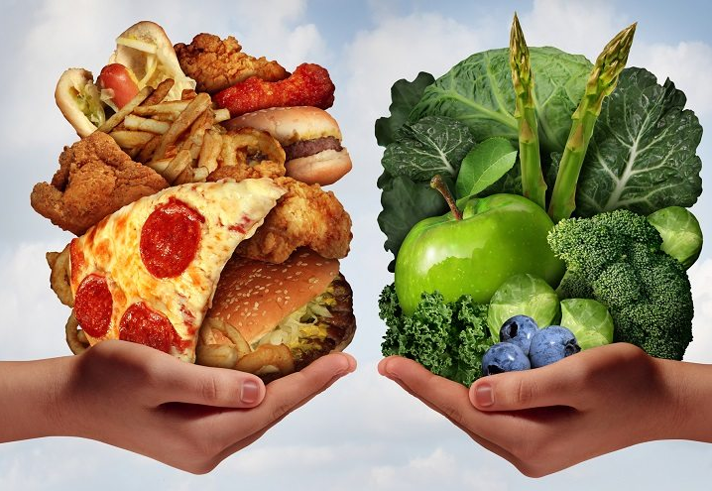
FAST FOOD
VS
HEALTHY FOOD

Slide 2
Introduction
Food has been known as an unavoidable component of life which makes it a basic necessity.
There are two main types of foods: healthy food and fast food.
Although they have some similarities, there are a lot of differences between them.
Healthy foods provoke energy and decrease the risk of so many diseases.
On the contrary, fast foods are high in sugar, salt and fat, which may lead to many health issues like heart and liver diseases.

Slide 3

Healthy food and fast food differ in their effect on health
A typical fast food meal is very high in calories and fat, and it doesn 't offer that much of the nutritional value.
Fast food contains a lot of artificial colors, preservatives and chemicals.
In the same way, many people think it is cheaper to buy a fast ready meal which it is not true.

Slide 4

Impact of Food Advertising on Childhood Obesity
Recent research has indicated that there is a clear link between the food and drink advertisements that children are exposed to and their food choices, cravings and eating patterns (Obesity Health Alliance, 2017). Increases in childhood obesity are thus a natural response to the persuasive and sophisticated techniques utilised by corporations on multiple platforms; such as television (TV), mobile phones and tablets (Smith, 2019).

Slide 5
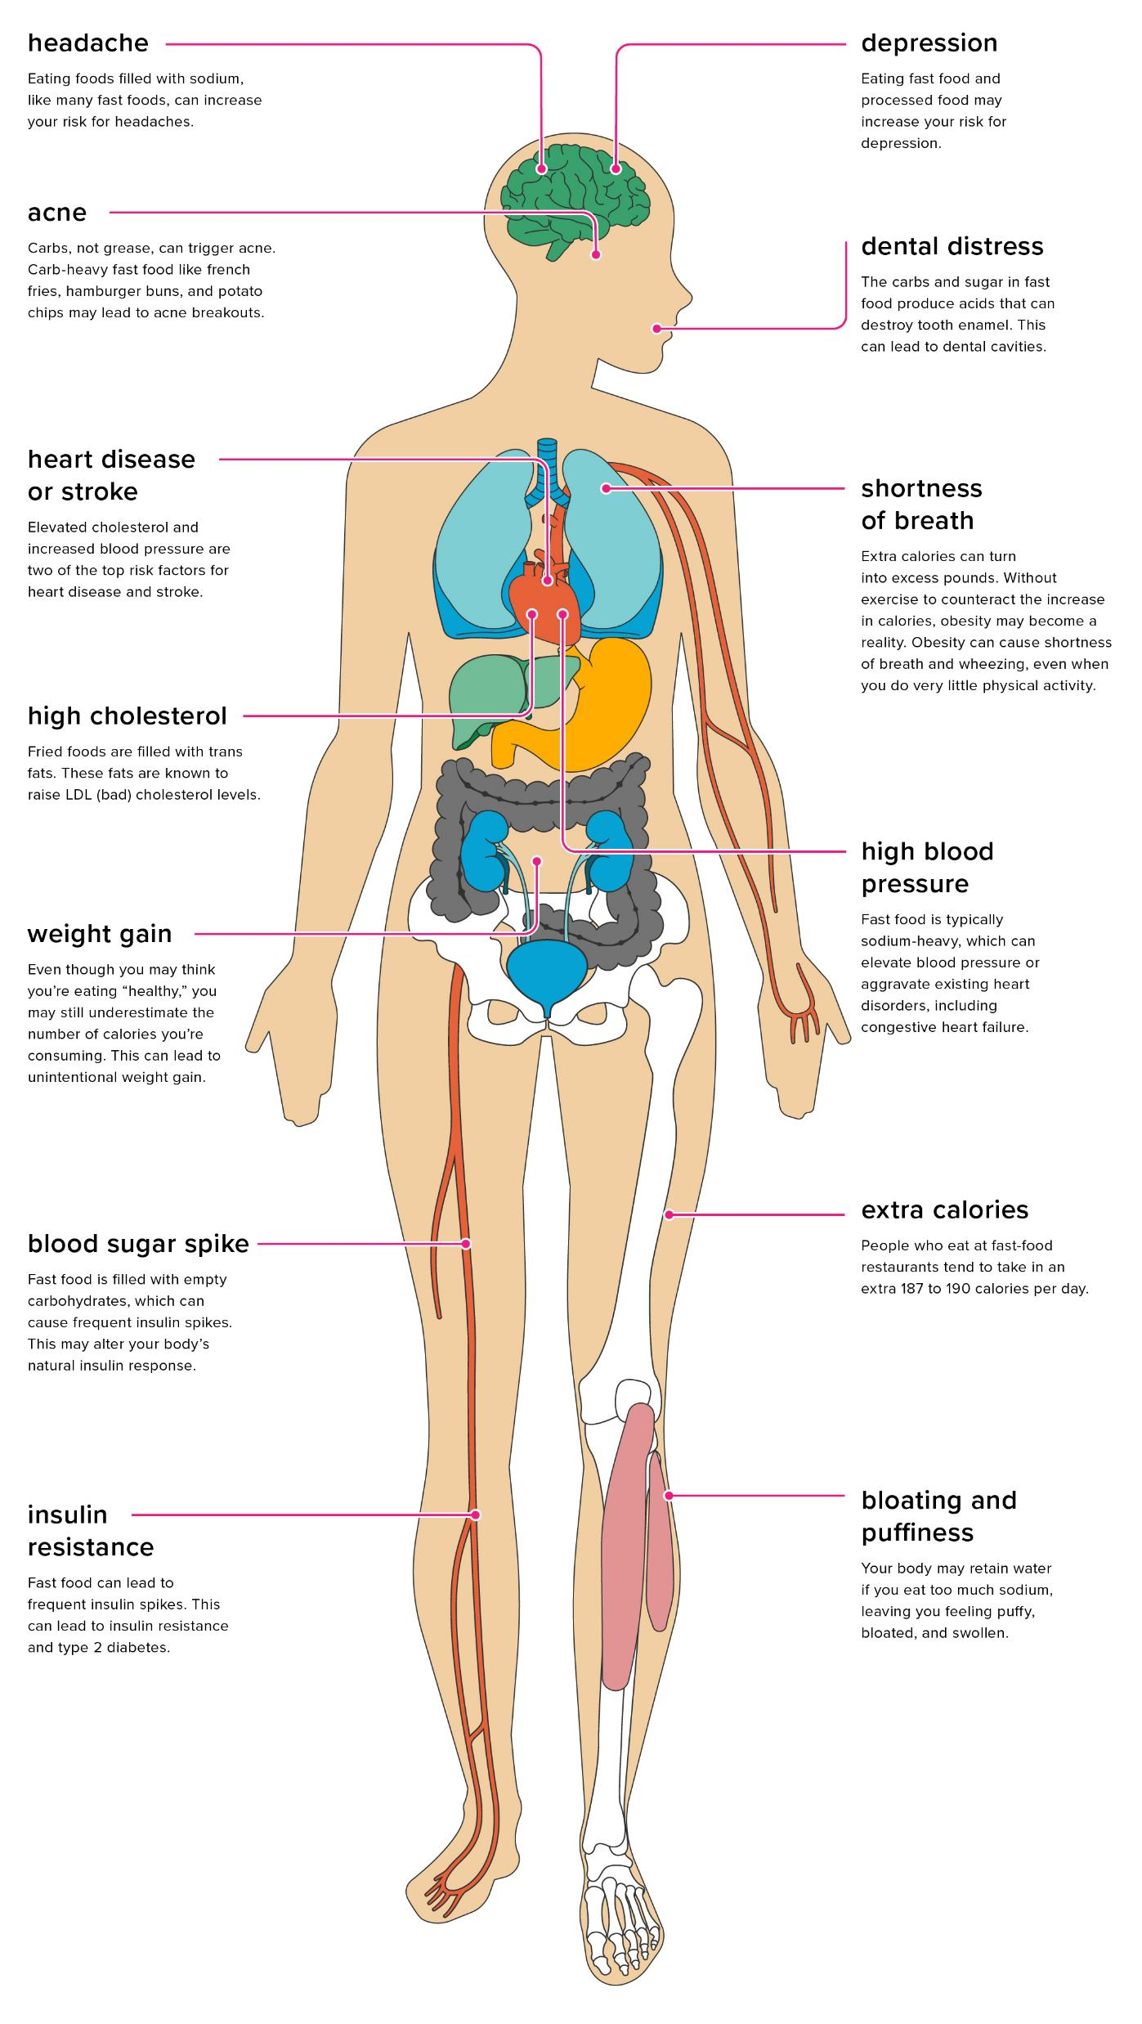
Effects of
fast food
on the body

Slide 6
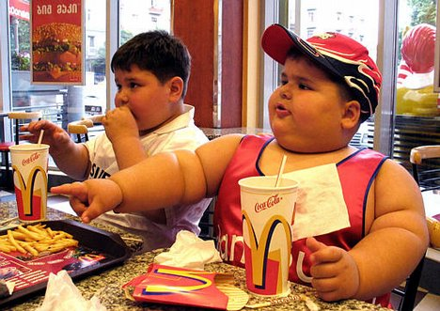
Causes Obesity
This is one of the most common effects of junk food. Junk foods are full of calories, sugars and fats that are the main reasons for gaining weight.
Induces Learning and Memory Problems
The hippocampus region of our brain is responsible for learning and memory. Due to an intake of foods loaded with sugars, a sudden inflammation occurs in the hippocampus region.
This is one of the harmful effects of junk food.
Impacts the Respiratory System
Obesity will give rise to respiratory problems like shortness of breath and asthma.
It is extremely difficult to breathe while walking, doing exercises, and climbing in such a situation.
.

Slide 7
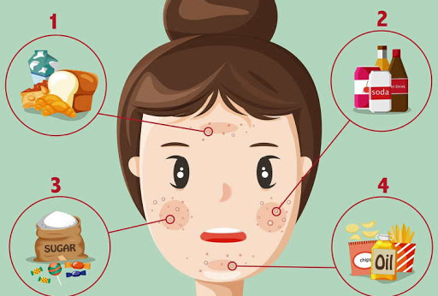
Effects on Skin
Food items high in carbs will cause blood sugar spikes, which in turn may cause acne.
According to a study, adolescents and children having fast food three times or more in a week can develop eczema. Eczema is a skin disease causing irritated patches of inflamed skin.
Harmful Effects on Central Nervous System
As per recent research and study, people who have processed pastries and fast food are 51% more likely to develop depression than those not having such foods or consuming a few of them.
May Impact Reproductive System
Excess fat or adipose tissue in the body alters the levels of estrogen, insulin and leptin and this escalates the timing of puberty.

Slide 8

Side Effects on Skeletal System
Obese people are prone to breaking bones. Consuming food items with optimum levels of carbs along with exercise can strengthen bones.
Kills Appetite
One may feel good about junk food as it fills the stomach for long hours. However, there is a catch! You may lose your appetite subsequently. Losing appetite is one of the harmful effects of junk foods.
Causes Digestive Problems
People may end up eating more than what is required due to the fluctuating levels of blood sugar. It makes the brain demand more quantity of food than what is needed.

Slide 9
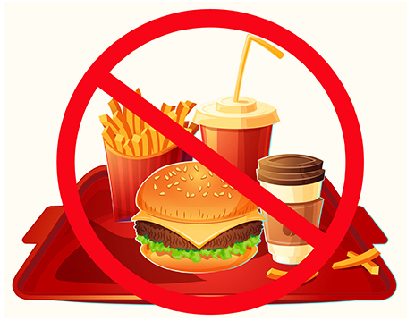
Fast food is of negligible health benefits.
In the short run, it may satisfy hunger, but results are less favourable in the long run.
Essential nutrients are key to healthy growth and development.
Now, junk food lacks basic nutrition too. Such unhealthy habits and insufficient levels of nutrition will affect the development of the brain and various other parts of the body.
As a result, nutritionists do not favour intake of processed foods in excess due to their ill effects on a body’s growth and development.

Slide 10
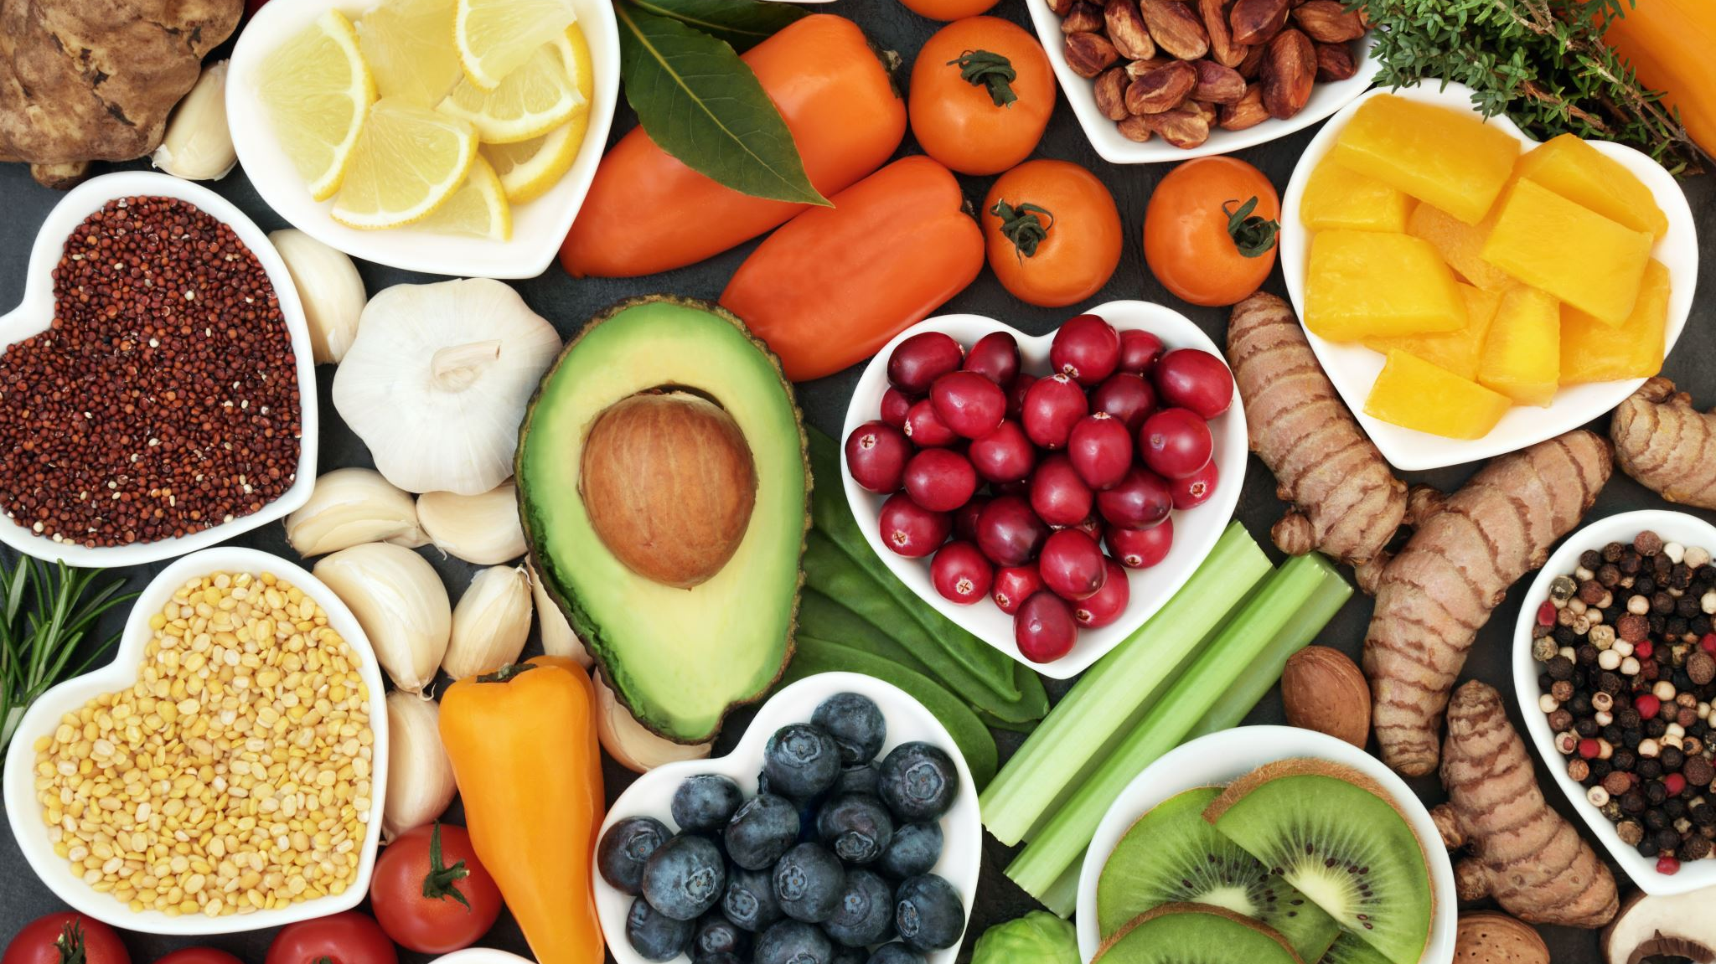
Healty food
It’s easy to wonder which foods are healthiest.
A vast number of foods are both healthy and tasty.
By filling your plate with fruits, vegetables, quality protein sources, and other whole foods, you’ll have meals that are colorful, versatile, and good for you.

Slide 11
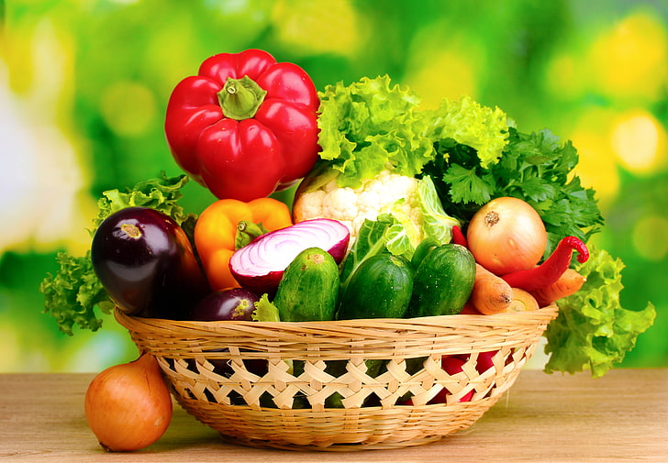
Vegetables
Calorie for calorie, vegetables are among the world’s most concentrated sources of nutrients.
There’s a wide variety available, and it’s best to eat many different types every day.
Broccoli it’s an excellent source of fiber and vitamins C and K.
Carrots are extremely crunchy and loaded with nutrients such as fiber, vitamin K., very high in carotene antioxidants and which have numerous benefits.
Cucumbers are contain a number of nutrients in small amounts, including vitamin K.
Tomatoes are tasty and loaded with nutrients such as potassium and vitamin C.
Bell peppers are crunchy and sweet and are a great source of antioxidants and vitamin C.
Most vegetables are very healthy: onion, Brussels sprouts, cabbage, celery, eggplant, leeks, lettuce, mushrooms, radishes, squash, Swiss chard, turnips, and zucchini.

Slide 12
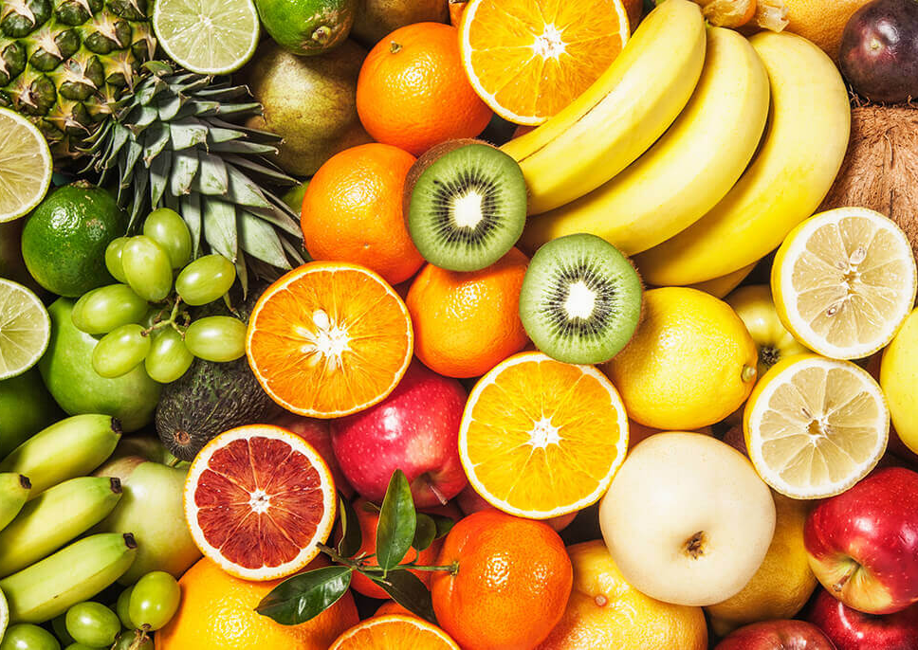
Fruits
Fruits and berries are among the world’s most popular health foods. These sweet, nutritious foods are very easy to incorporate into your diet because they require little to no preparation.
Apples are high in fiber, vitamin C, and numerous antioxidants. Its a perfect snack!
Avocados are not only creamy and tasty but also high in fiber, potassium, and vitamin C.
Bananas are among the world’s best sources of potassium and are also high in vitamin B6 and fiber.
Blueberries are not only delicious but also among the most powerful sources of antioxidants in the world.
Oranges are well known for their vitamin C content, in fiber and antioxidants.
Strawberries are highly nutritious. They’re loaded with vitamin C, fiber, and manganese. Its most delicious foods in existence.
Other healthy fruits and berries: cherries, grapes, grapefruit, kiwi, lemons, mangoes, melons, olives, peaches, pears, pineapples, plums and raspberries.

Slide 13
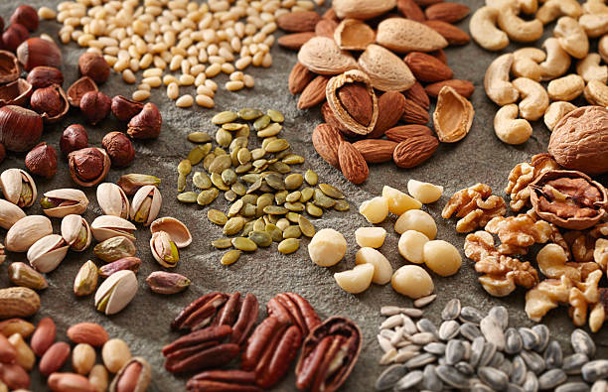
Eggs
Eggs are among the most nutritious foods on the planet.
Nuts and seeds
Some people develop nut allergies as they grow older. If you have a reaction after eating any kind of nut, eliminate it from your diet.
Despite being high in fat and calories, nuts and seeds may aid in weight loss.
These foods are crunchy, filling, and loaded with important nutrients that many people don’t get enough of, including magnesium and vitamin E.
They also require almost no preparation, so they’re easy to add to your routine.
Exemple: Almonds, Chia seeds, Coconuts, Walnuts, Brazil nuts, sunflower seeds, susan, caju.

Slide 14
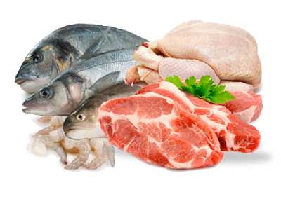
Fish and seafood
Fish and other seafood tend to be very healthy and nutritious.
They’re especially rich in omega-3 fatty acids and iodine, two nutrients that most people don’t consume enough of.
Studies show that people who eat the highest amounts of seafood — especially fish — tend to live longer and have a lower risk of many illnesses, including heart disease, dementia, and depression.
Exemple: Salmon, Sardines, Shellfish, Shrimp, Trout, Tuna and many more.
You should make sure to buy low mercury varieties!
Meats: unprocessed meats can be included in a healthy diet.
Lean beef is among the best sources of protein when consumed in moderation and is loaded with highly bioavailable iron.
Chicken breasts is low in fat and calories but extremely high in protein. It’s a great source of many nutrients. Again, feel free to eat fattier cuts of chicken if you’re not eating many carbs.
Lamb are usually grass-fed, and their meat tends to be high in omega-3 fatty acids.

Slide 15
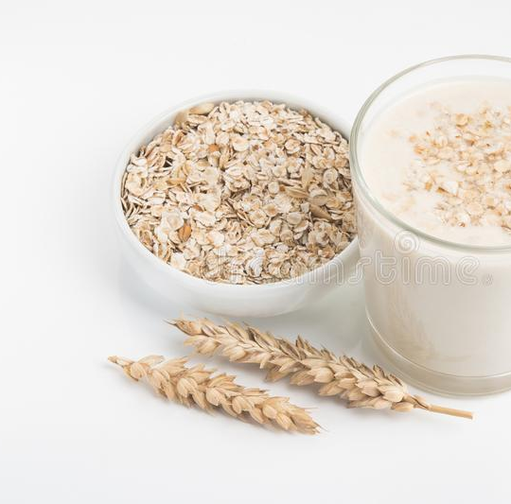
Dairy
For those who can tolerate them, dairy products are a healthy source of various important nutrients.
Cheese is incredibly nutritious — a single slice may offer about the same amount of nutrients as an entire cup (240 ml) of milk.
Whole milk is very high in vitamins, minerals, quality animal protein, and healthy fats.
Yogurt is made from milk that is fermented through the addition of live bacteria.
Grains
Whole grains are an important addition to your diet because they provide a variety of micronutrients and fiber and are fuel for your body.
They’re not recommended for those who are on low carb diets.
Exemple: Brown rice, Oats, Quinoa.

Slide 16
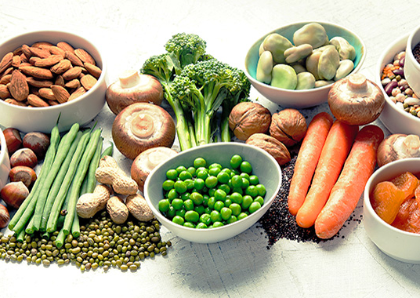
Legumes
Legumes are a great plant-based source of protein, iron, and fiber.
Exemple: Green beans, Kidney beans, Lentils, Peanuts (which are legumes, not true nuts).
Tubers
Tubers are the storage organs of some plants. They tend to contain potassium and contain a little bit of almost every nutrient you need, including vitamin C.
Exemple: Potatoes, Sweet potatoes.
Fats and oils
Dietary patterns that include unsaturated fats and oils are considered very healthy.
Exemple: Extra-virgin olive oil, sunflower.

Slide 17
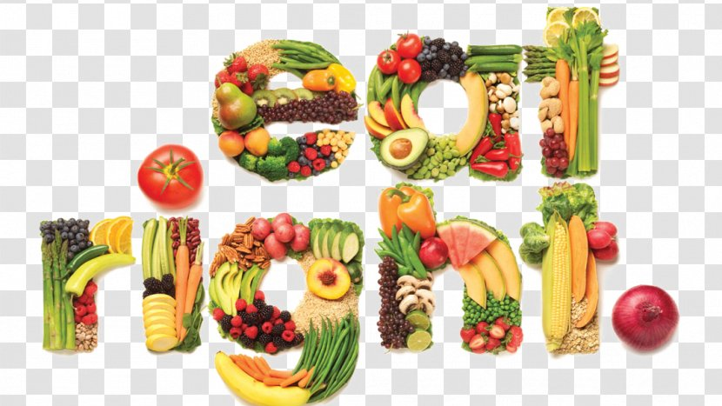
Eat healthily and responsibly
for a fitter you!

